Slide 1
Fantastic 4: Our Team
Our team, Fantastic 4, is dedicated to developing a reliable and innovative gas detection system. We have combined our expertise in electronics, software, and chemistry to create a solution that can effectively identify and measure different gases.
Swam Singla
Shubham Goel
Inesh Dheer
Shreyas Mehta

Slide 2

Report:
Inesh | Shreyas | Shubham | Swam
Wrote the Results and Discussion part of the Research paper. Performed the experiments. Assisted in soldering. Assisted in the testing of the qualitative sensor and found inconsistencies. | Compiled the Research paper. Read the research paper sent by Srikar Sir. Did the testing of the new sensor (given by Srikar sir) and found inconsistencies. | GUI Done. Assisted in soldering. | Did the complete analysis part of the Results and Discussion part of the Research paper. Performed the Experiments with Inesh. Assisted in soldering.

Slide 3
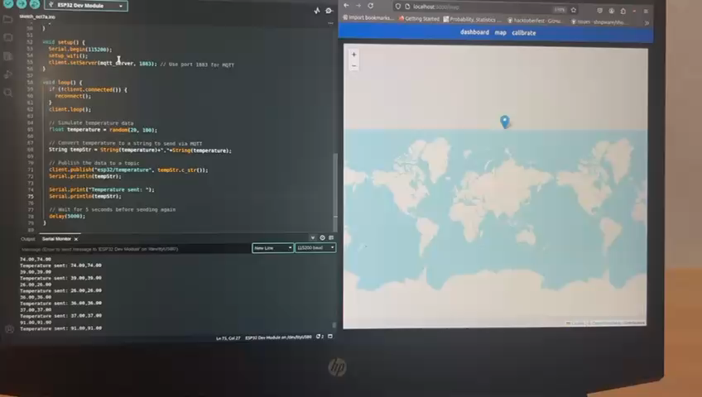

Slide 4
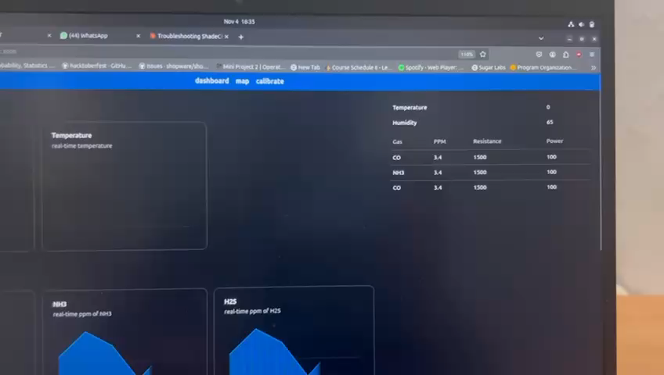

Slide 5
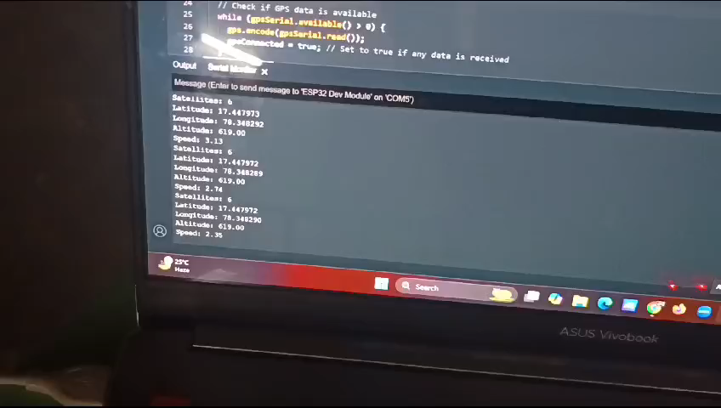

Slide 6
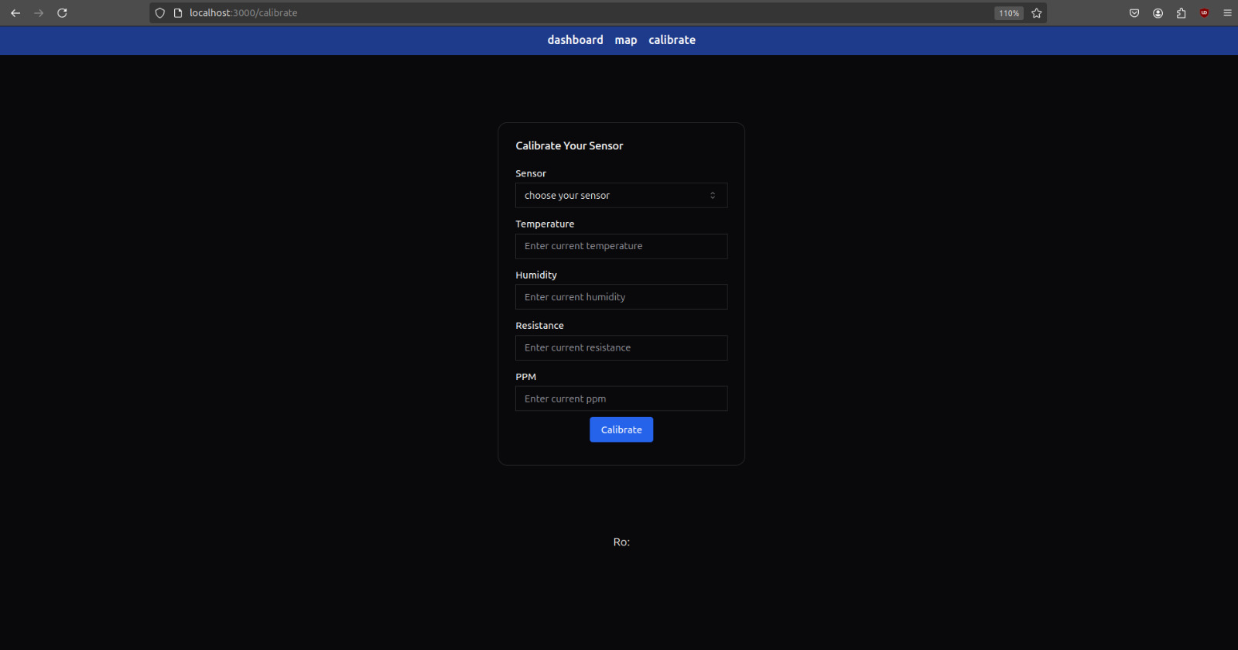

Slide 7
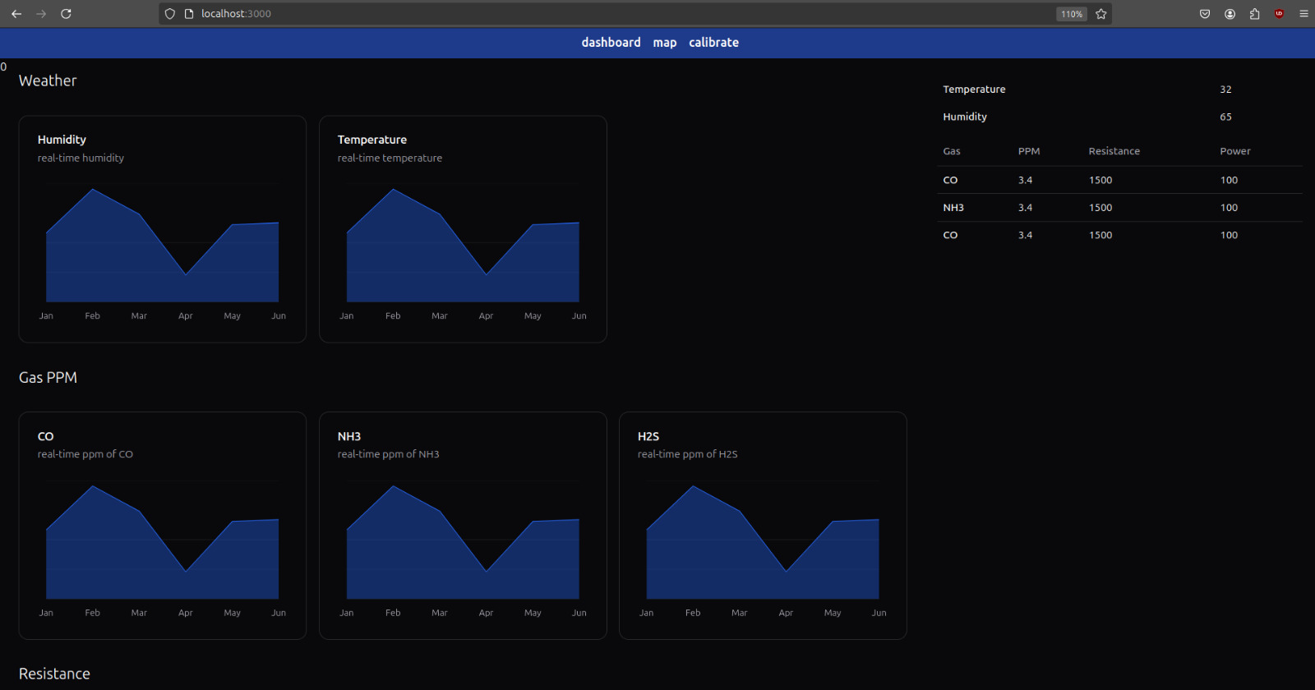

Slide 8
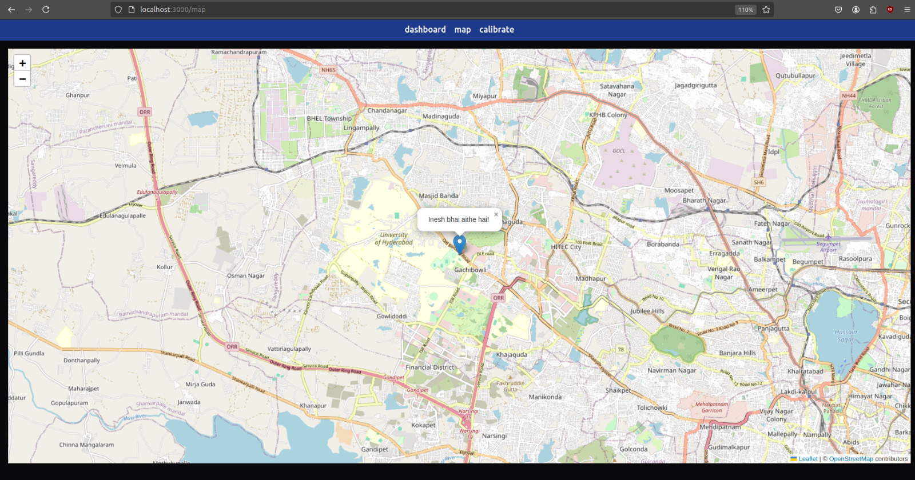

Slide 9
Targets for next week/ Any Suggestions ?
Objectives:
Will try to complete the entire working part of the project. (Hardware) 3-D printing will be started.

